Slide 1

IT & DA Audit Team Meeting - February
February 25, 2021

Slide 2
General Updates
Lynn Atkin
2021 Audit Plan Overview
Lynn Atkin
Gamification Overview
Terri-Ann Quiambao
Legacy Policy to Control Standard Mapping
Shawn Sousa
IT Audit Roles and Responsibility: RACI Matrix
IT Audit Management Team
AuditBoard Updates/Training Insights
Eric Mata
Open Forum
Team

Slide 3
General Updates

Slide 4
2020 IT/DA Audit Status

Slide 5
2021 Audit Plan Overview

Slide 6
2021 IT Audit Plan

Slide 7
Gamification Overview

Slide 8

Discussion Points
Gamification Scoring Review
Gamification Data
Gamification Updates Template
Q & A
*** REMINDER: Gamification ends before 9AM EST on Friday, 2/26 ***

Slide 9
Gamification Scoring Review
Scoping & Planning
Testing
Collaboration
250 Points – Descriptive Analytics Perform descriptive analytics (ELI dashboard or at least 3 descriptive analytics manually)
500-1,500 Points – Audit Issue
500 for low, 1,000 for Moderate and 1,500 for high (Data analytics on your own or working with DA Team)
400 Points – Blogging
Sharing your analytics experience through the newsletter
350 Points – Lunch & Learn
Presenting a business case during a Lunch & Learn
100 Points – Analytics Planning Meeting Discussion with Audit Manager regarding the Data Analytics Strategy
300 Points – Presenting to the Business
Present the Audit Analytics work performed during the audit
100 Points – Contribute Documentation within the Resource Library
Post resources and articles within the MS Teams resource page
100 Points – Know Your Numbers (KYN) Present one-page summary to the Audit Leadership about the results of the Descriptive Analytics
300 Points – Data Science / RPA
Working with DA Team to use Data Science or RPA for audit.
Self-Development
1,000 Points – Analytics Rotation
Perform a one-month rotation with the Analytics Department
400 Points – Prescriptive Analytics
Prescriptive analytics performed for an audit.
50 Points – Analytics Audit Program
Create analytics framework of the audit tests in scope
300 or 100 Points – Participate in the weekly Alteryx Challenge
First submission is 300 and 100 each after that
Helpful Links
Points Collector
Gamification Dashboard
Analytics Gamification
Some FAQ
POC: Konrad Wisniewski (WisniewskiK@aetna.com)

Slide 10
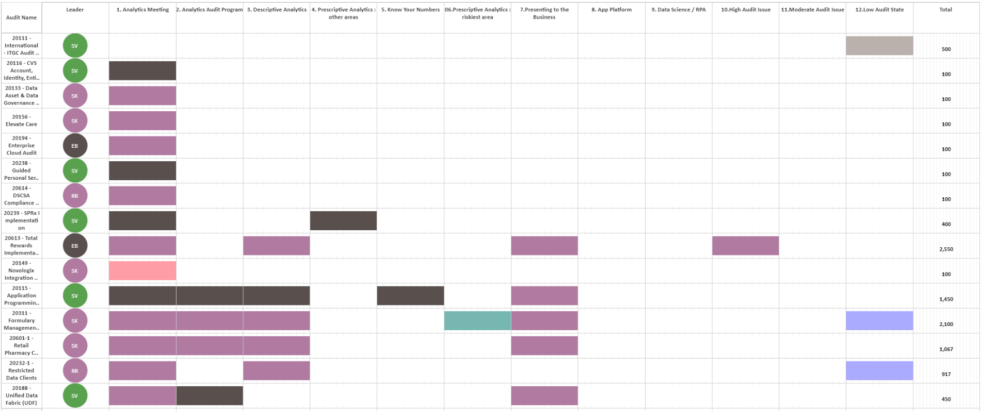
Gamification Data
POC: Matthew Colville (ColvilleM@aetna.com)
TOTAL: 10,134 pts

Slide 11
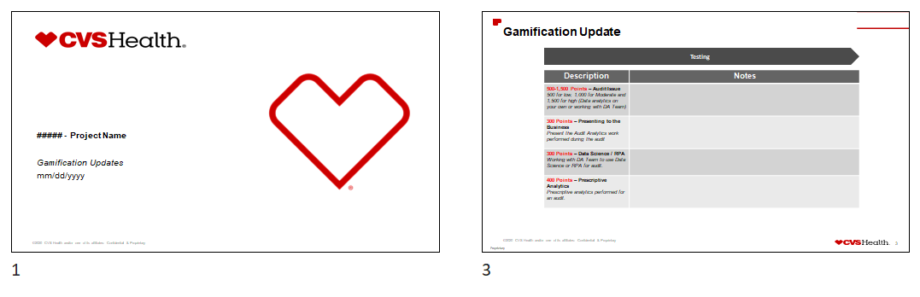
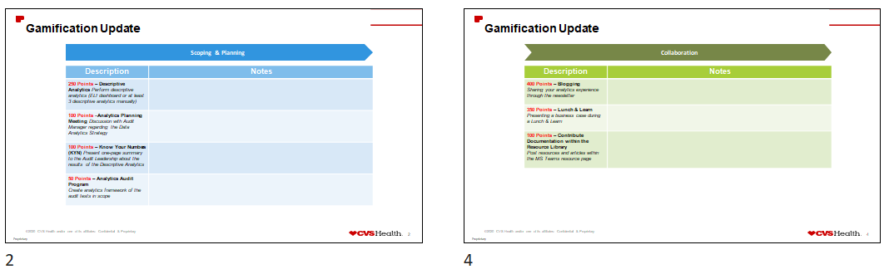
Gamification Updates Template

Slide 12
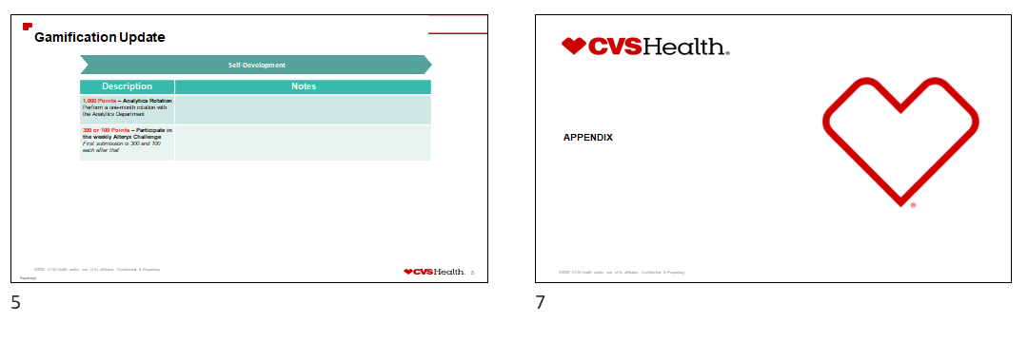
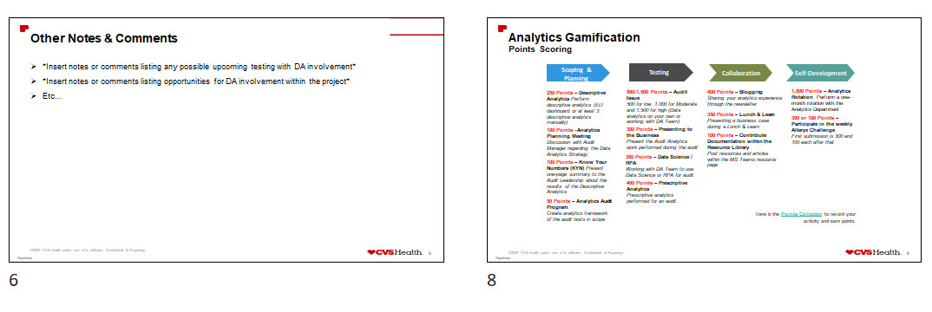
Gamification Updates Template

Slide 13

Q & A

Slide 14
Legacy Policy - Control Standard Mapping

Slide 15
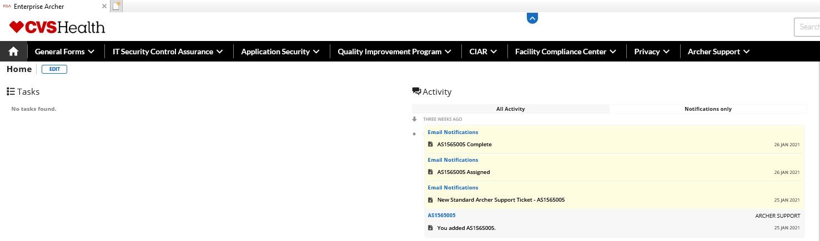
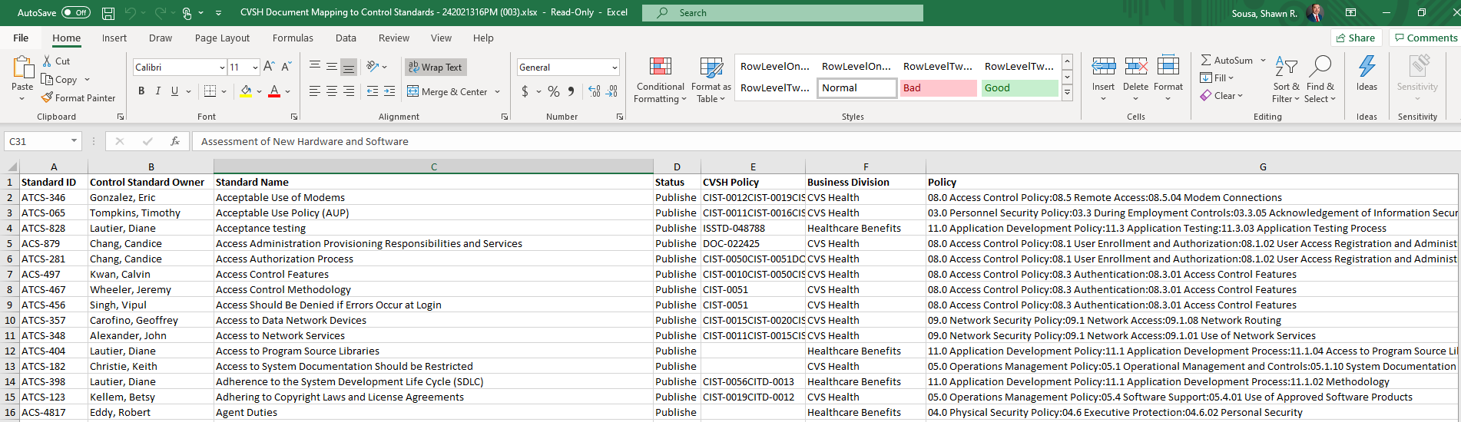
Enterprise eGRC Archer
Official Link:
Enterprise eGRC
Purpose:
Consolidated Policy & Procedure Portal
Application Security
Third Party Risk
Privacy/CIAR
Full mapping spreadsheet:

Slide 16
Live Demonstration
Notes:
Begin with navigation to the Enterprise eGRC site. (Can use official link or previous link from HCVS Archer which directs the user to the enterprise site.
Start with explaining the uses of modules described in the previous slide.
Touch on the unique landing page/modifications that can be made to fit the user’s purpose of Archer (ie. Homepage brings you right to the P&P portal) DO NOT go too in-depth.
Navigate to the P&P portal.
Perform search navigation
Perform trickle down navigation (breadcrumb approach) (click thru)
Show example of previous Standard Documentation (spreadsheet) and navigation to new policies/procedure
Navigate to the Findings.
Perform search for Findings to highlight gaps identified and acted on by the business during background/planning/scoping.
Navigate to the Application Security module.
Perform search for application and security documents. (Read-Only). *Note: Not all IA users have access to the Application Security module. Potential to gather list and submit a ticket with all IA users?
Touch on Privacy/CIAR – No in-depth navigation

Slide 17
IT Audit Roles and Responsibility: RACI Matrix

Slide 18
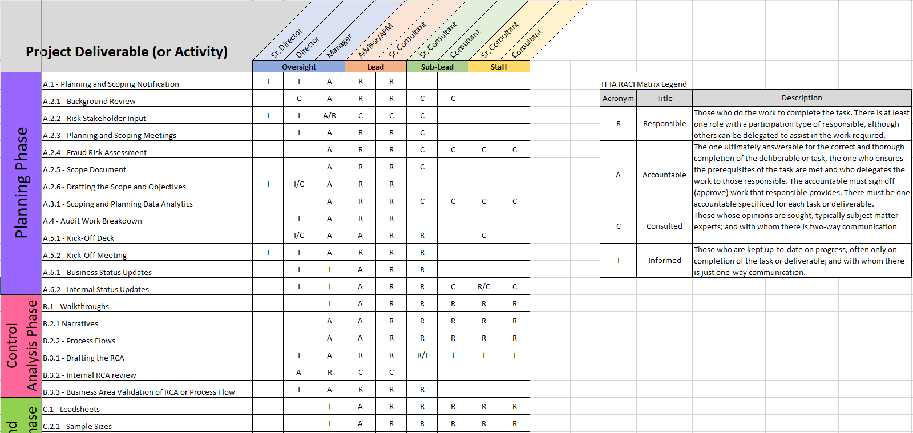
IT Audit Roles and Responsibilities RACI Matrix
Used for setting expectations at the beginning of each audit engagement.

Slide 19
AuditBoard Updates/Training Insights

Slide 20

AuditBoard Updates
Release Notes (January)
https://support.soxhub.com/hc/en-us/articles/1260801167409-Release-Notes-January-2021-1-
https://support.soxhub.com/hc/en-us/articles/1260801746029-Release-Notes-January-2021-2-
Release Notes (February)
https://support.soxhub.com/hc/en-us/articles/1260802067510-Release-Notes-February-2021-1-
https://support.soxhub.com/hc/en-us/articles/1260802693150-Release-Notes-February-2021-2-
Further Information
Helpful information such as release notes, user guides, and documentation found in the AB help center:
https://support.soxhub.com/hc/en-us

Slide 21




Training Insights
Audit trainings offered through different mediums:
The IIA Training Offerings
IT Audit trainings offered through different mediums:
ISACA Greater Hartford Chapter Events
ISACA Rhode Island Chapter Events
ISACA New England Chapter Events
ISACA Global Events
Data analytics trainings offered internally (online):
Big Data Interpretation
Data Analytics using Power BI: Concepts
Data Analytics Using Power BI: Data Sourcing and Preparation
Data Analytics Using Power BI: Data Modeling and Visualization
Azure Fundamentals
Introduction to GitHub
Introduction to DevOps & GitHub

Slide 22

Deloitte Cloud Training – 101 – March 15, 2021
Time | Length (min) | Module
1:00-1:05 | 5 | Introductions
1:05–1:15 | 10 | Cloud 101
1:15–1:25 | 10 | Cloud service models
1:25–1:35 | 10 | Cloud deployment models
1:35–1:50 | 15 | Shared responsibility concept
1:50–1:55 | 5 | Break
1:55–2:05 | 10 | Cloud Migration Overview
2:05–2:15 | 10 | Auditing Cloud
2:15–2:30 | 15 | Cloud risks considerations
2:30–2:40 | 10 | Demo
2:40–2:45 | 5 | Break
2:45-3:00 | 15 | Cloud control frameworks & regulation requirements
3:00–3:05 | 5 | SOC report considerations
3:05-3:35 | 30 | CVS Cloud environment
3:35–3:45 | 10 | Q&A

Slide 23
Open Forum “Hope this slide finds you in good spirits, preferably Gin, Whiskey, or Vodka.”

Slide 24
Open Forum
What is your favorite vacation spot and where do you plan to travel to first post- COVID?
What new habit have you developed during COVID (good or bad)?
What is one thing you are most excited about in 2021?
What do you consider your most interesting early job or career?
What song is at the top of your playlist right now?
If you could have dinner with anyone – dead or alive, real or imagined, who would it be and why?
How do you celebrate your successes?

